Slide 1
BARC Tube Bending Week 7

Slide 2
Checklist
Process: Manual Edge detection Smoothing edges Fitting lines to straight sections Angle Calculation Part 1 ( Bends 1 & 2) Part 2 ( Bends 2,3 & 4) Automated Edge detection Smoothing edges Fitting lines to straight sections Angle Calculation Part 1 ( Bends 1 & 2) Part 2 ( Bends 2,3 & 4) | Varying Parameters: Background Color Background Brightness Distance to LED box Height of camera Camera Orientation Lighting (Front vs Back) Different cameras/lenses Adding noise (non-ideal lighting conditions) No. of Cameras

Slide 3
2.4 Last week’s results
Smoothing improved accuracy of angle estimation
Using longer sections does not always give better results
What matters more than the length of section is how “clean” each section used is

Slide 4
Current Week Effort (Done for 2 heights)
Heights: 13 in and 21 in
We used two different criterion to fit a line to the edges of the tube:
Criterion 1: Fit a line to all data points in the edge or in a section of the edge
Criterion 2: Fit a line to only two data points in the edge that are a certain number of pixels apart
We plotted the angle error vs distance between terminal data points and compared results

Slide 5
All point fit (Criterion 1) vs 2-point fit (Criterion 2)

Slide 6
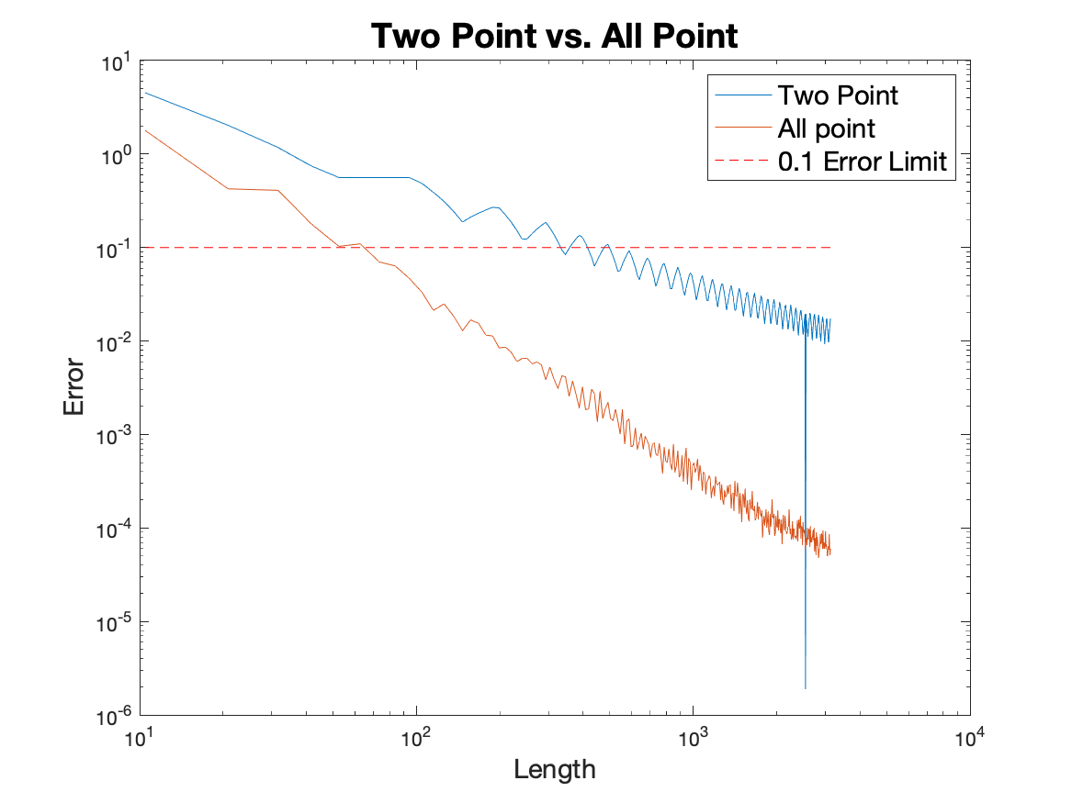
2 Point Fit vs. All Point Fit (ideal line)
Two point fit is worse than all point fit for the ideal case since there is more noise.
In practice the two point fit performs better.

Slide 7
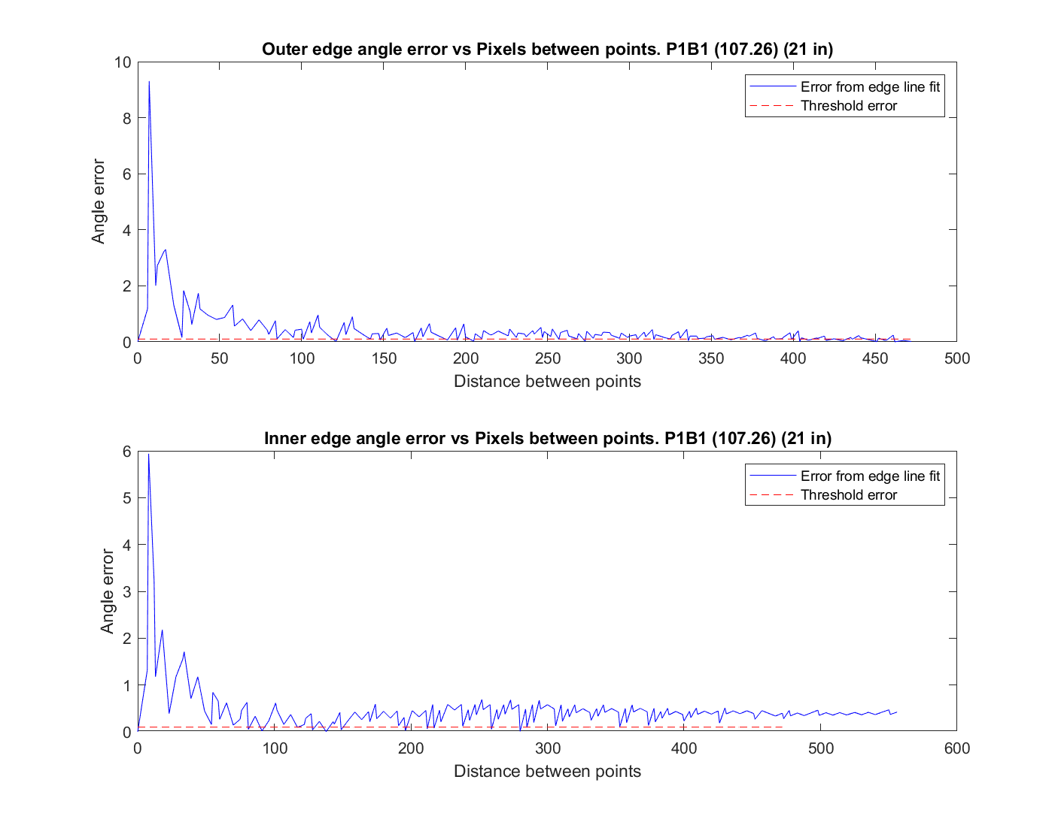
2 point fit results - P1B1 (error plot trend for 21 in)
General decreasing trend in the error as the distance between end points increases

Slide 8
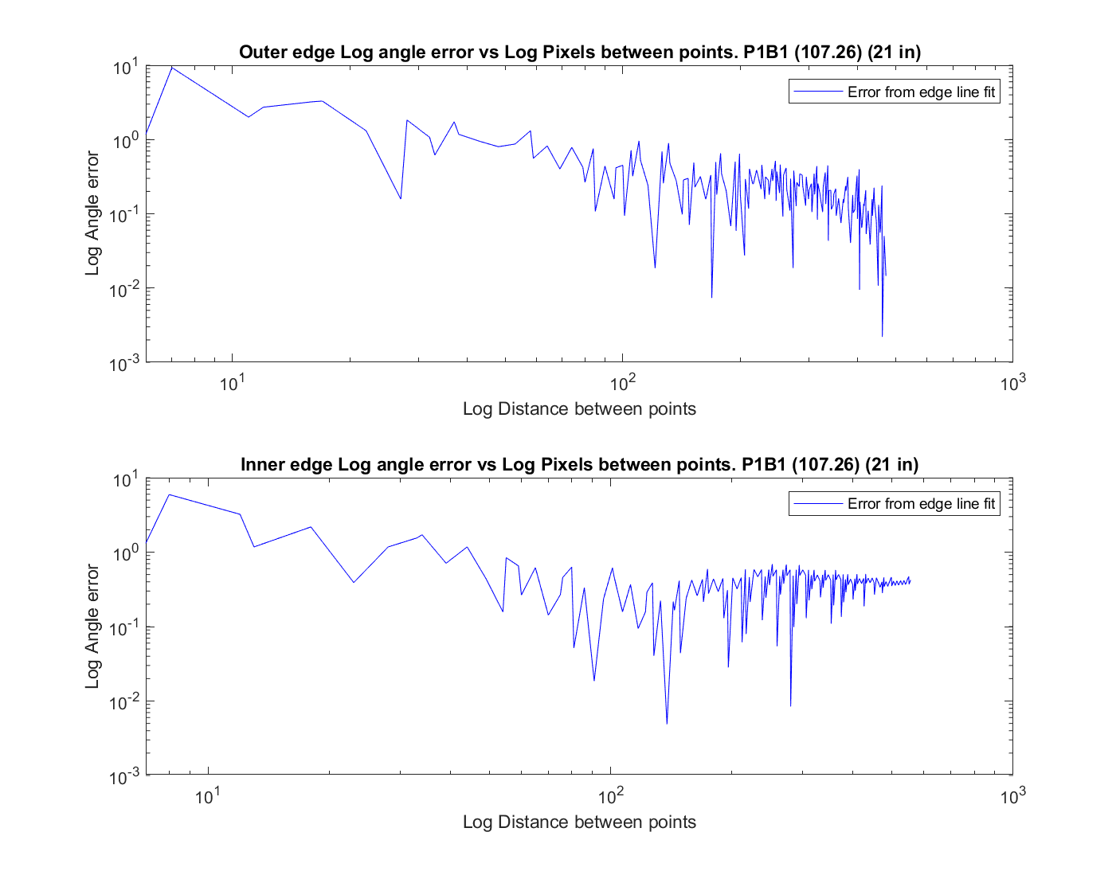
2 point fit results - P1B1 (log error plot trend for 21in)
Using the logplot we can observe that the relation might be linear
The logplot substantiates the trend shown in the plot from previous slide.

Slide 9
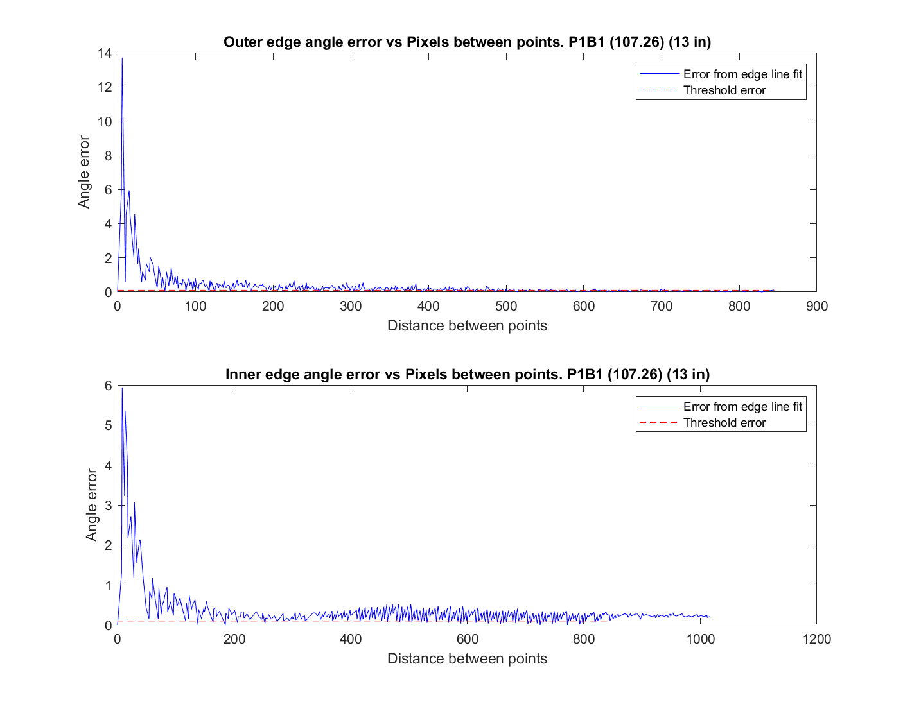
2 point fit results - P1B1 (error plot trend for 13 in)
Zoomed-in (outer edge)
The trend for 13 inches does much better than 21 inches.
The error falls below 0.1(desired) after around distance of 600 points (outer).

Slide 10
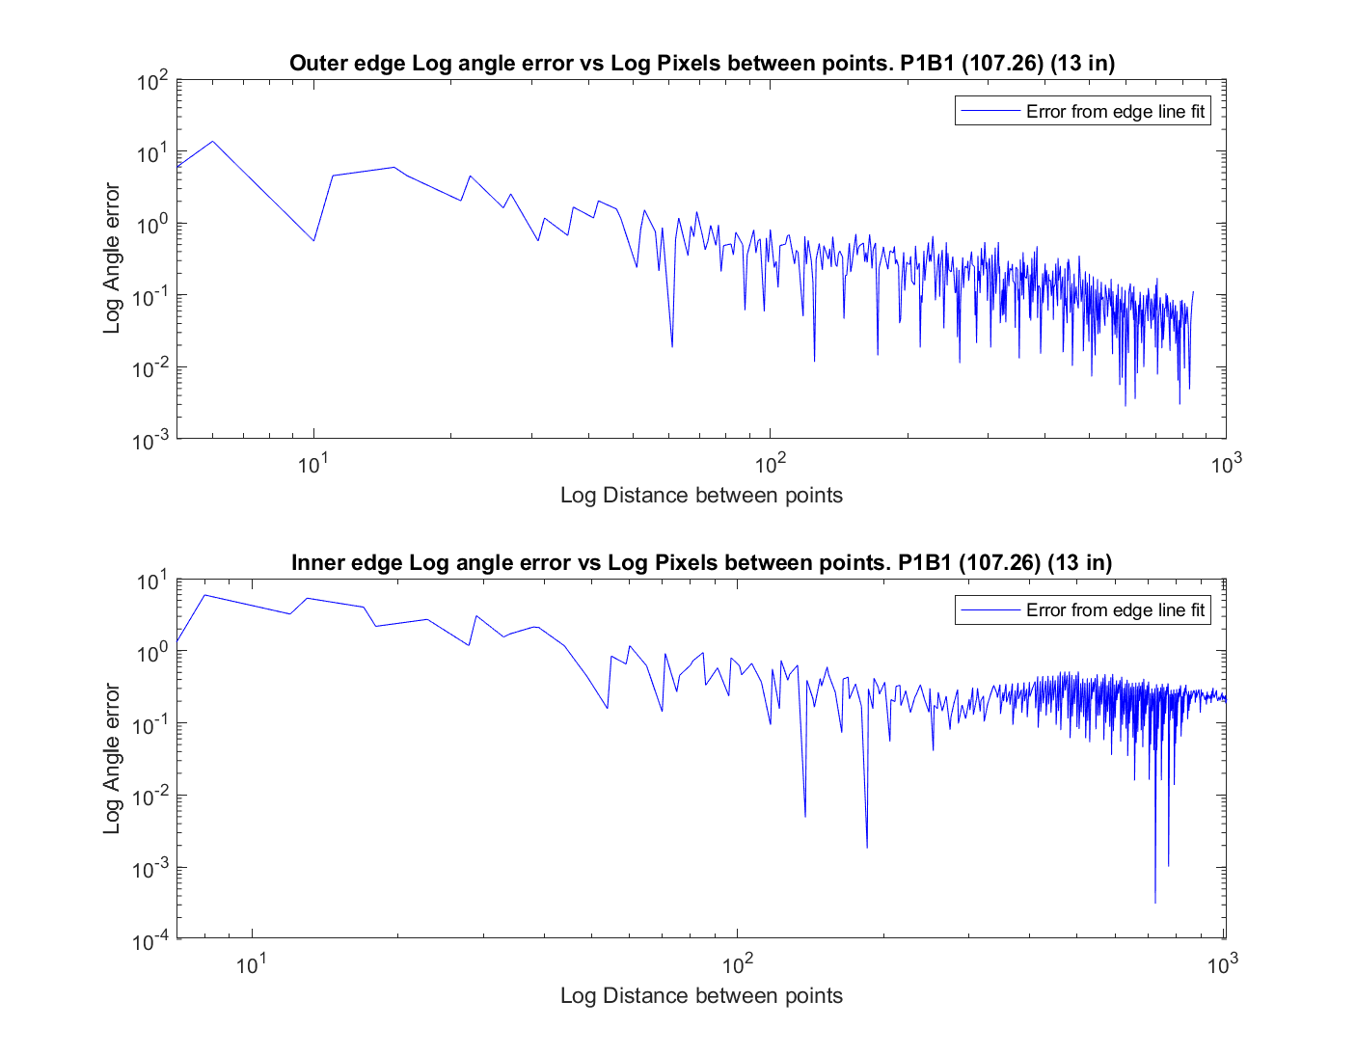
2 point fit results - P1B1 (log error plot trend for 13 in)

Slide 11
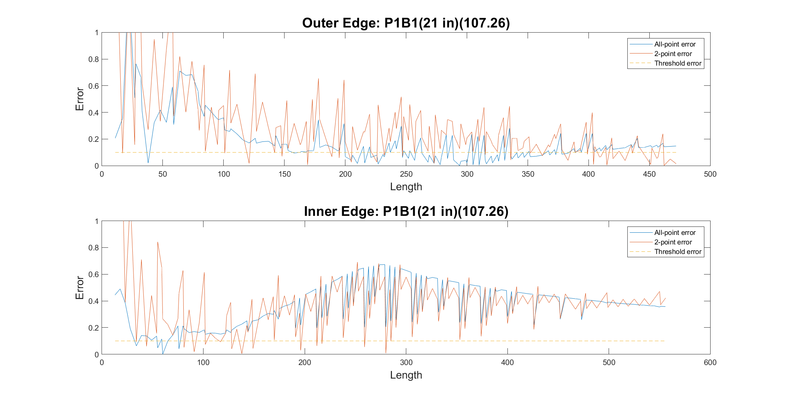
All point vs 2-point Error Comparison(P1B1)(21 in)
The 2-point error trend is more noisy compared to all-point trend.
This is because for all-point the noise cancels out whereas for 2-point it doesn’t.

Slide 12
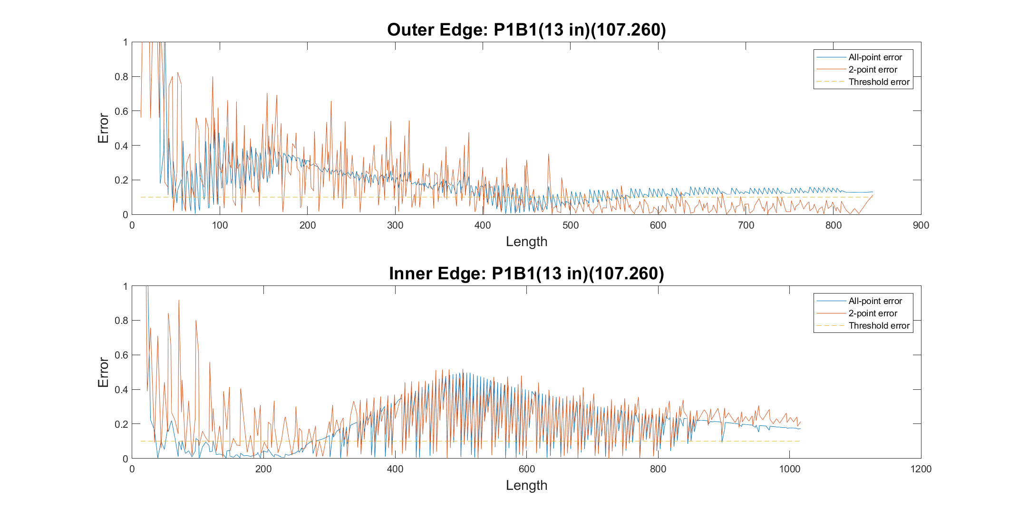
All point vs 2-point Error Comparison(P1B1)(13 in)
The 13 inch trend is much better as expected.
The 2-point trend is as observed before, more noisy.

Slide 13
Insights
Longer sections give lesser noise (variation) and result in a lower error
We clearly see that as we have more resolution (more pixels) we get a smaller error
Hence we conclude that we require a higher resolution camera to get below threshold error
Log(error) vs Log(distance) might be linear, if it is we can possibly get an expression for error as a function of straight section length.

Slide 14
Current Week Effort (Continued)
We also tested experimental repeatability by seeing how sensitive angle error is to slight perturbations in orientation of tube

Slide 15
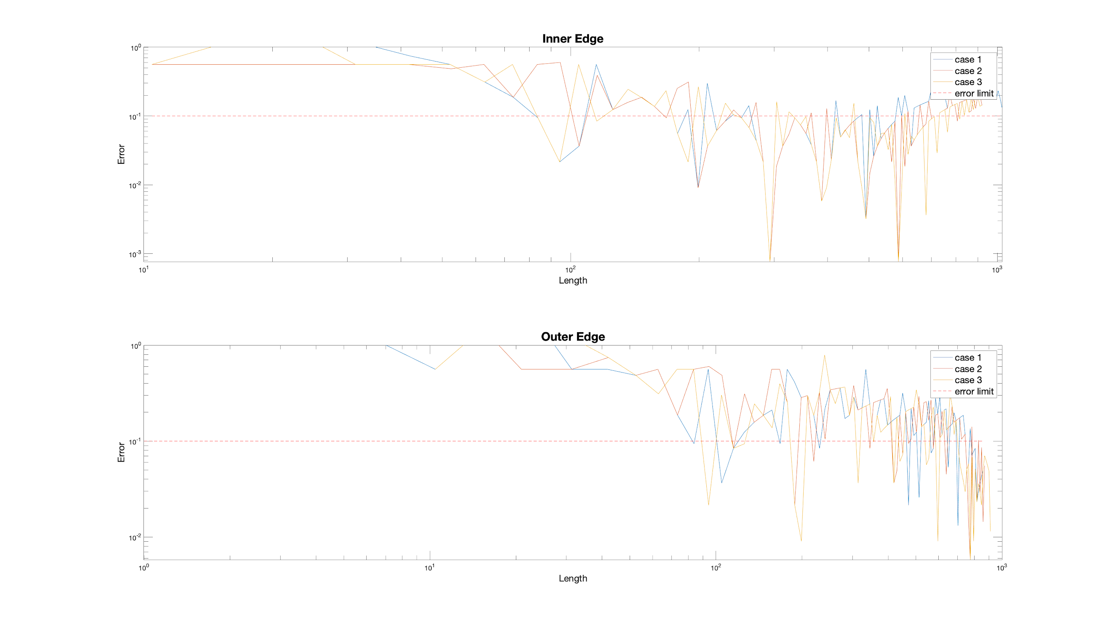
P1B1
The result for 3 cases are nearly the same.
But for high accuracy requirement, it is better to take more pictures and average the result.

Slide 16
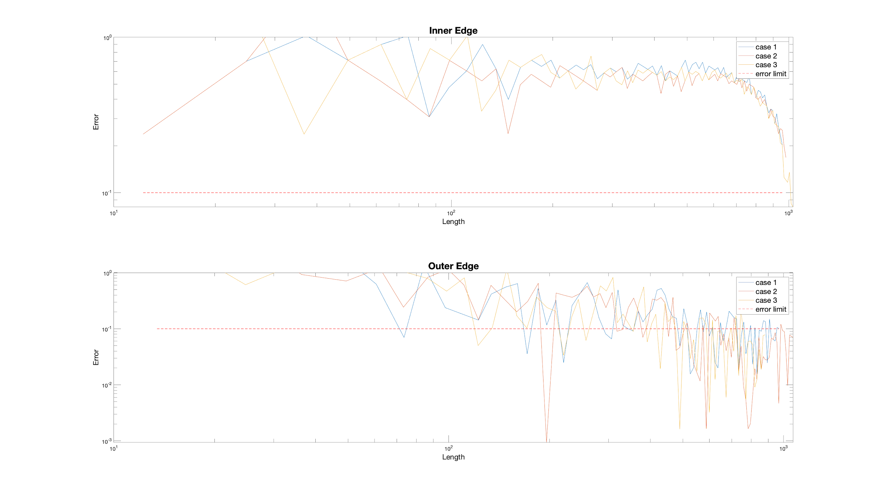
P1B2

Slide 17
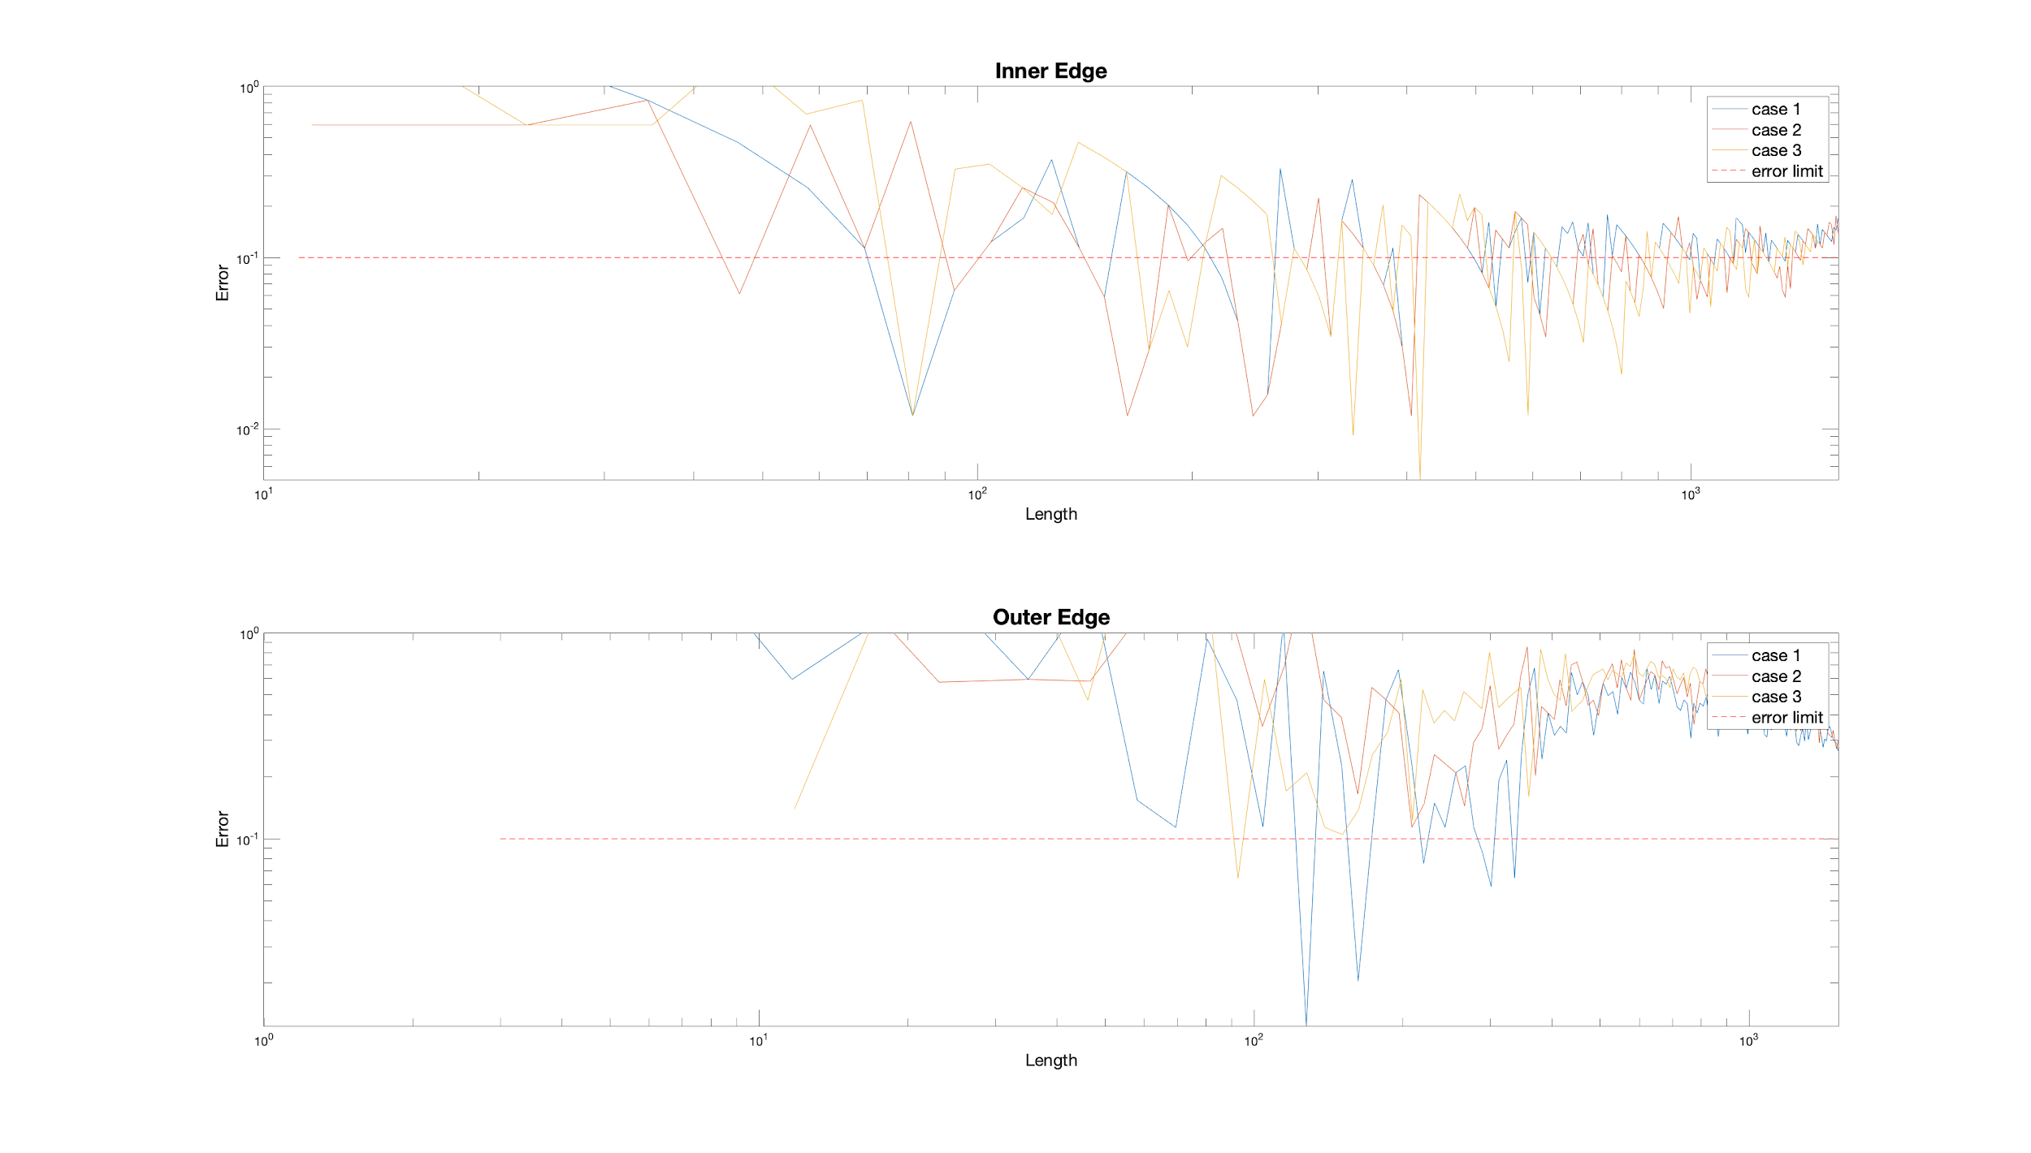
P2B2

Slide 18
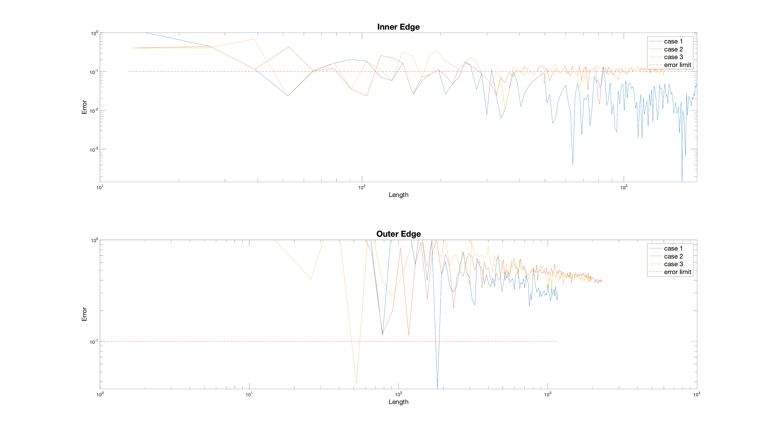
P2B3

Slide 19
Insights
Experiment setting also introduce errors. Might be tube orientation, camera placement, lighting, etc.
Change of focus must be done carefully and it can only focus at one of the edges each time.

Slide 20
Future work
Automate fitting lines to straight sections. Once we have a camera with a high enough resolution the angle error we get from the fitted lines will be below the required threshold.
Find a way to ensure that the tube is perpendicular to the camera. Do more tests to find how sensitive the angle is to orientation of tube.
Try to find an expression for angle error as a function of length of section.

